Slide 1
ArtBrowser
B.Sc. Project System Development
Prof. Dr. Bernhard Humm
SS 2019

Slide 2
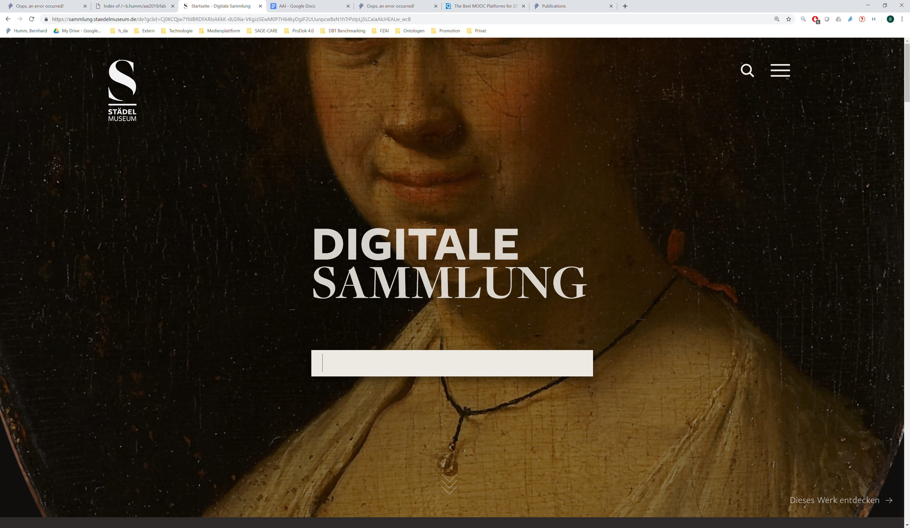
Inspiration: Digitale Sammlung Städel Museum https://sammlung.staedelmuseum.de

Slide 3
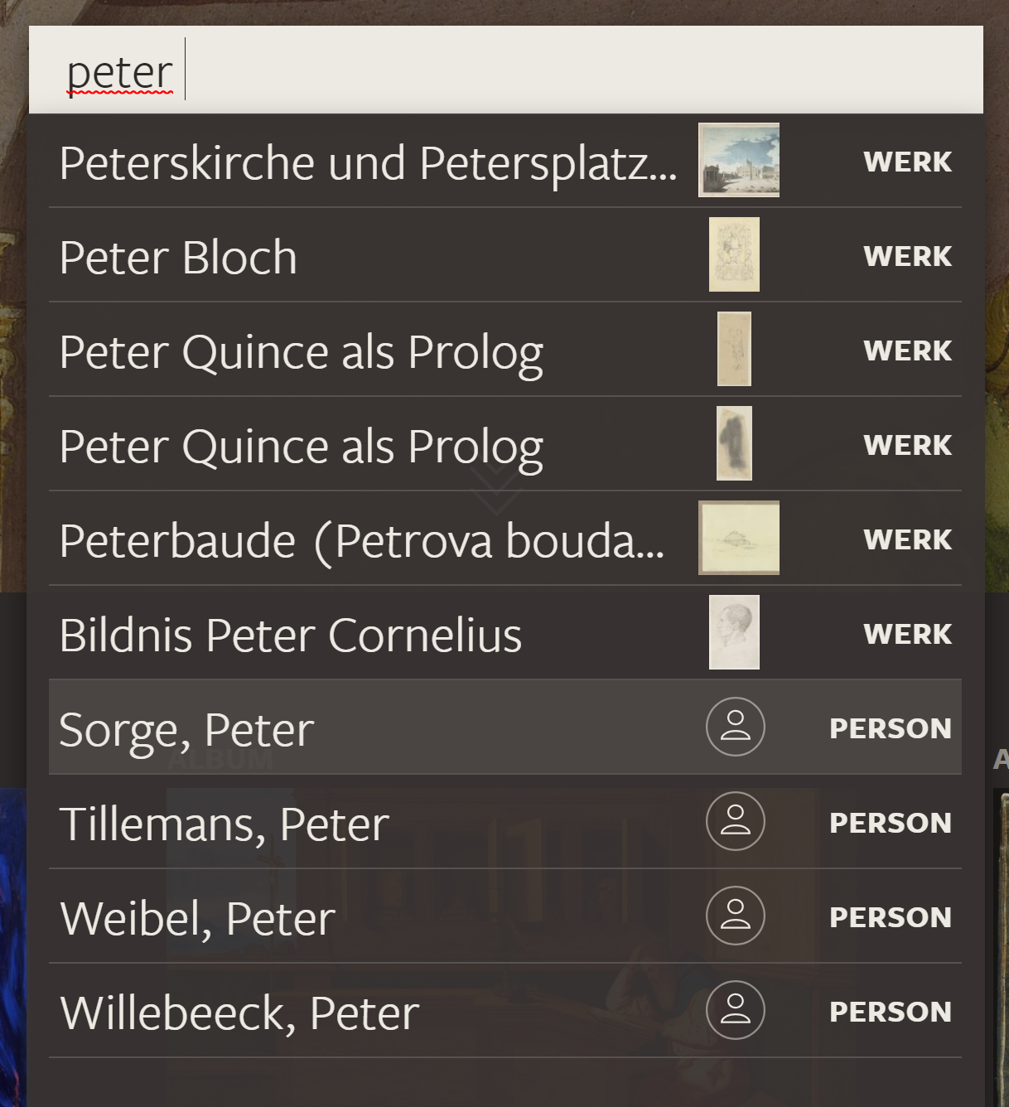
Semantic AutoSuggest

Slide 4
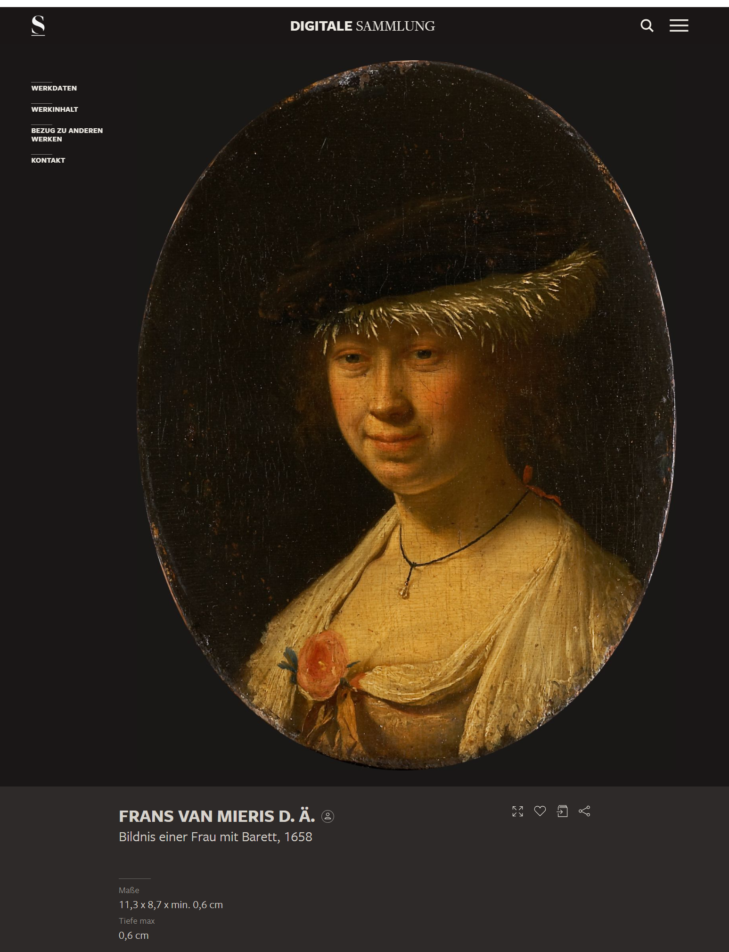
Artwork and metadata

Slide 5
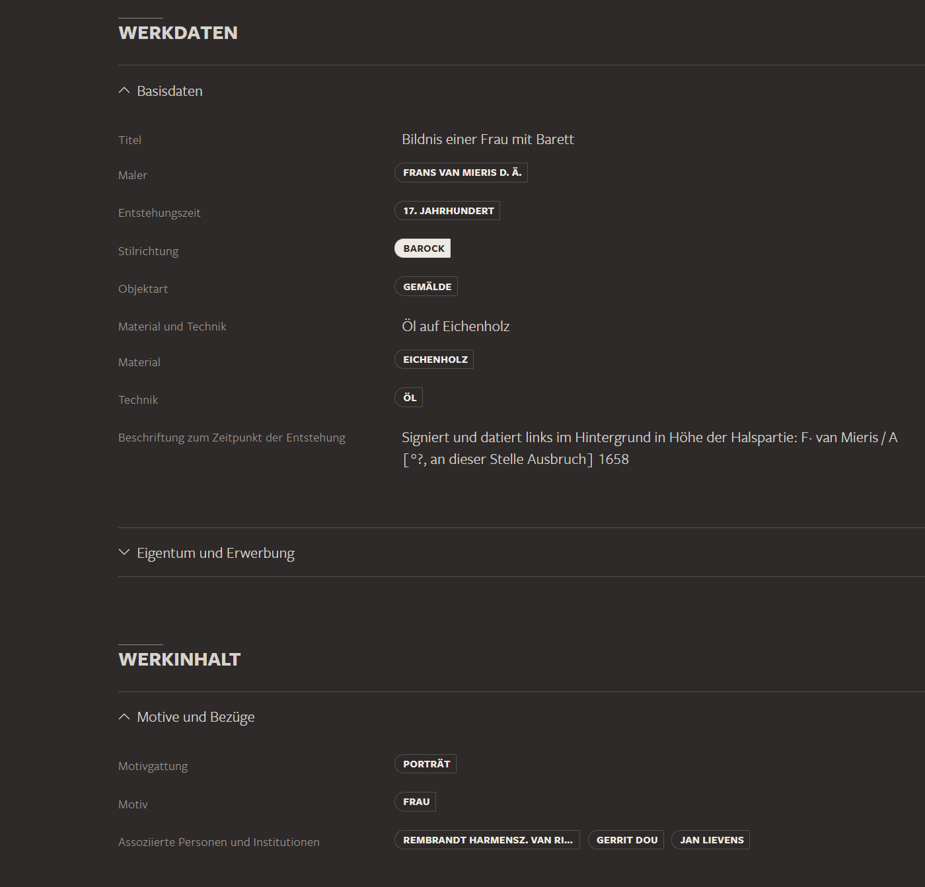
Metadata as hyperlinks (chips)

Slide 6
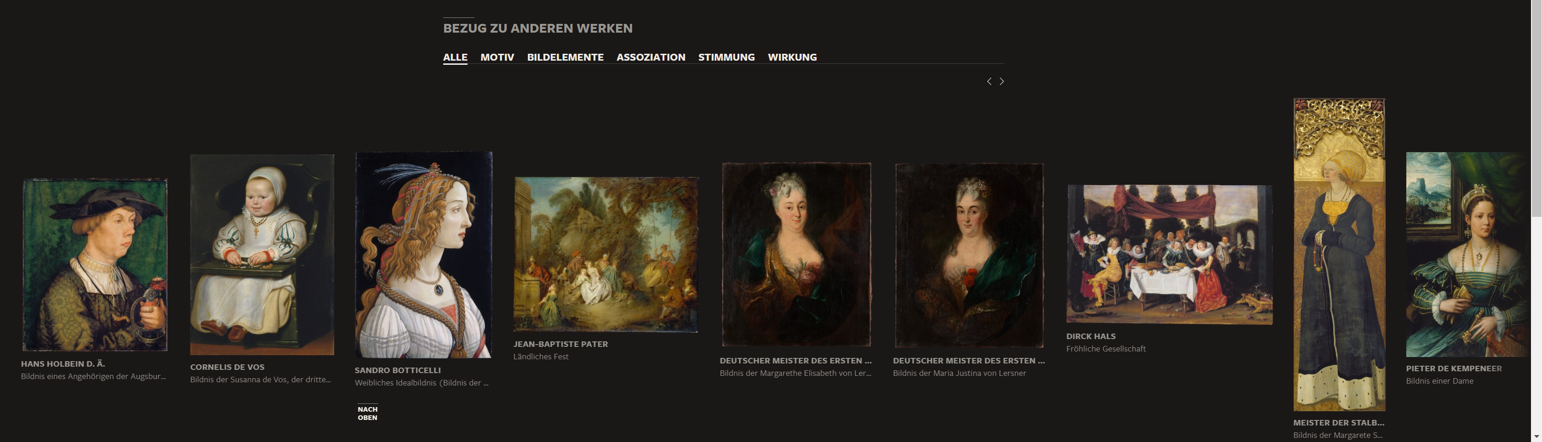
Related artworks according to category
Categories: artist, movement, genre, objects, material, location, all

Slide 7
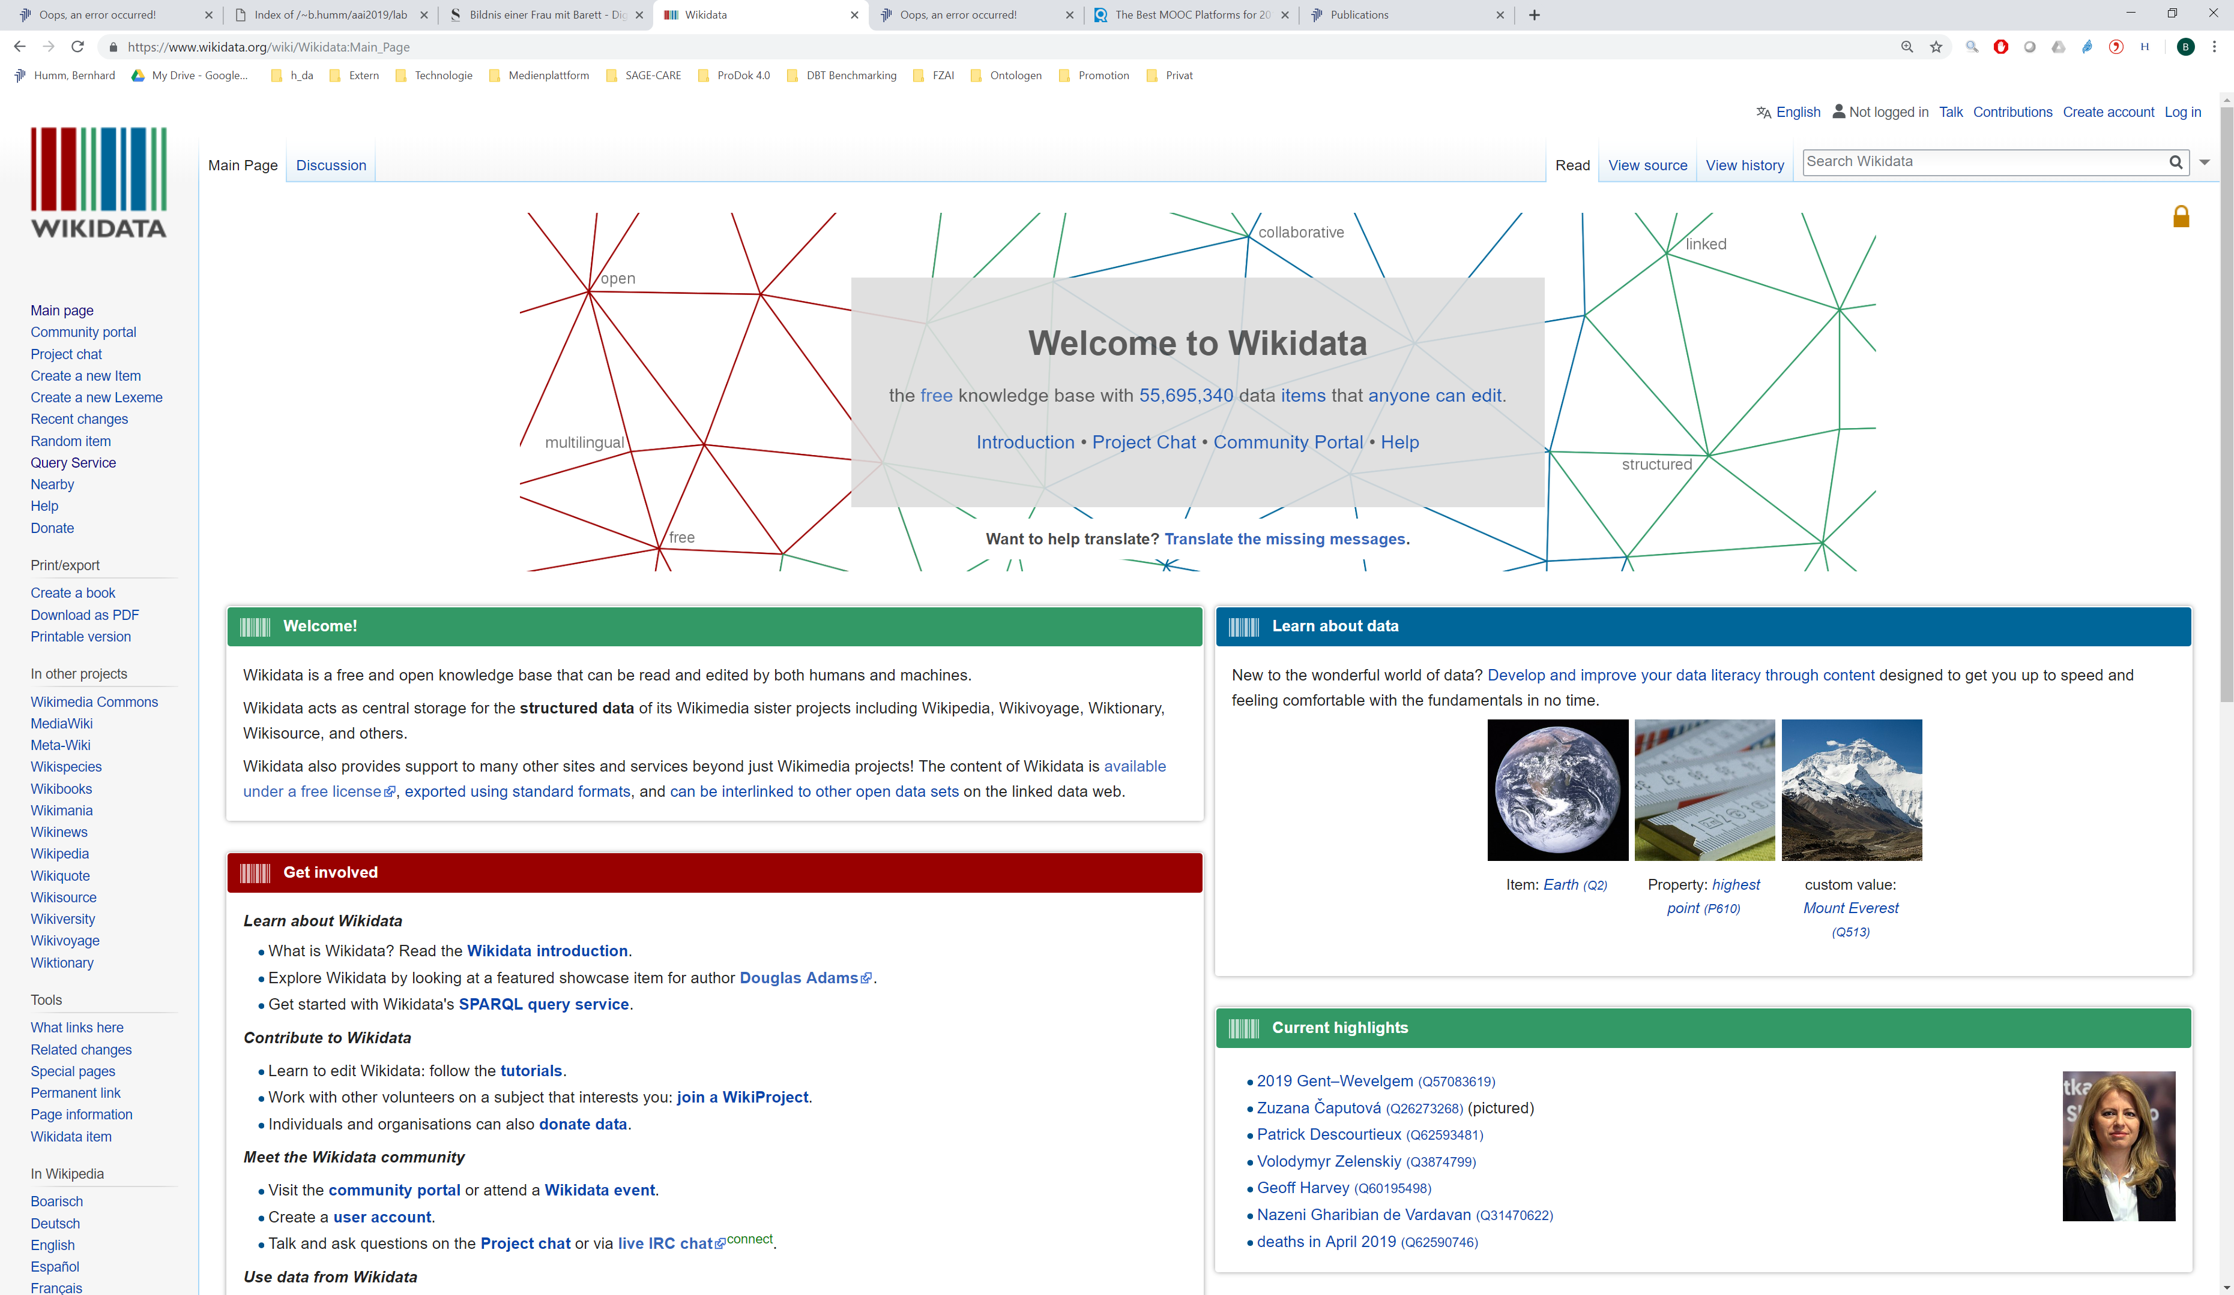
Data source: Wikidata https://www.wikidata.org

Slide 8
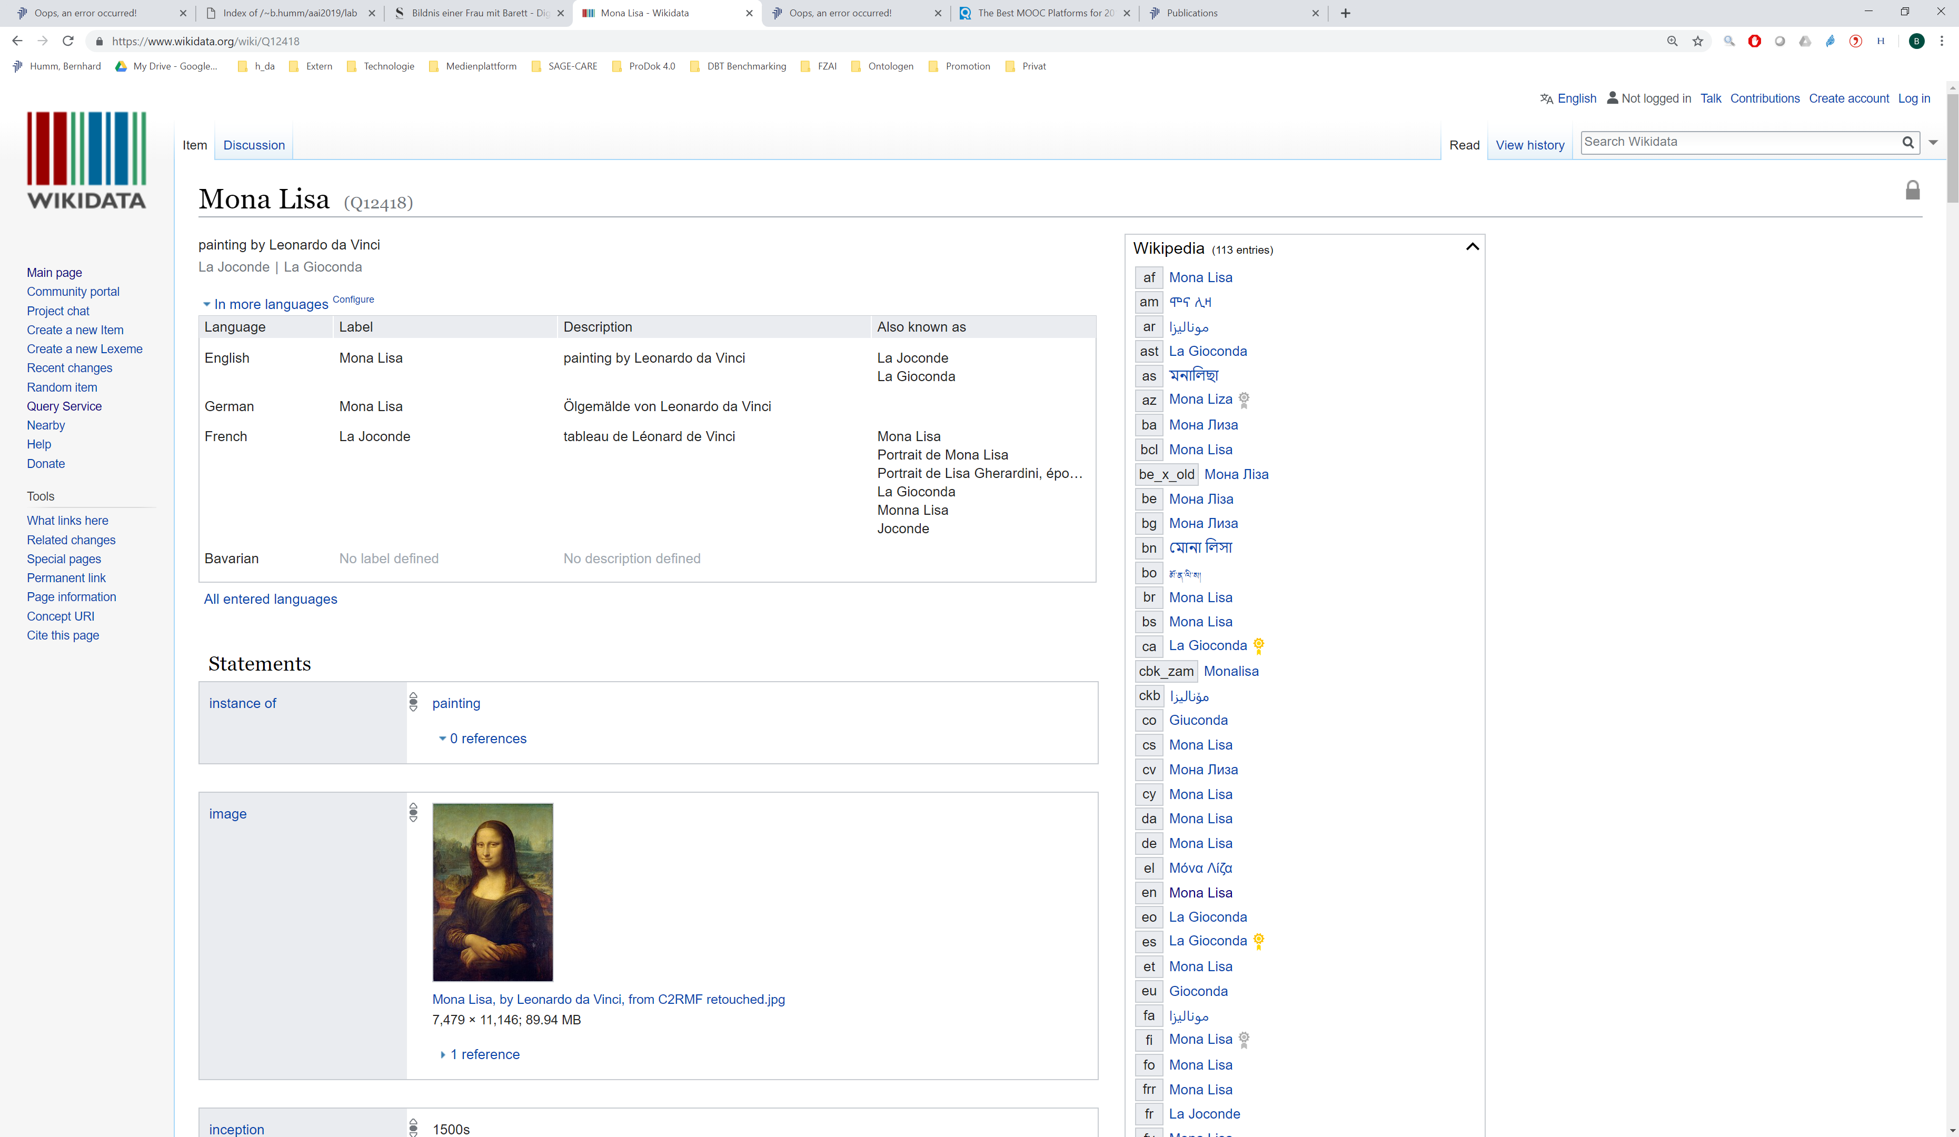
100,000 paintings, drawings, sculptures, artists, movements, genres, museums,…

Slide 9
Data model overview

Slide 10
Data model details

Slide 11




Software architecture

